Slide 1
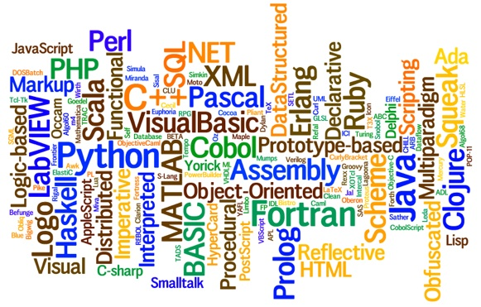
CS445 Programming Languages Slides 3 – Historical Development of PL
By Talha Waheed, UET Lahore

Slide 2
Course Learning Objectives

Slide 3
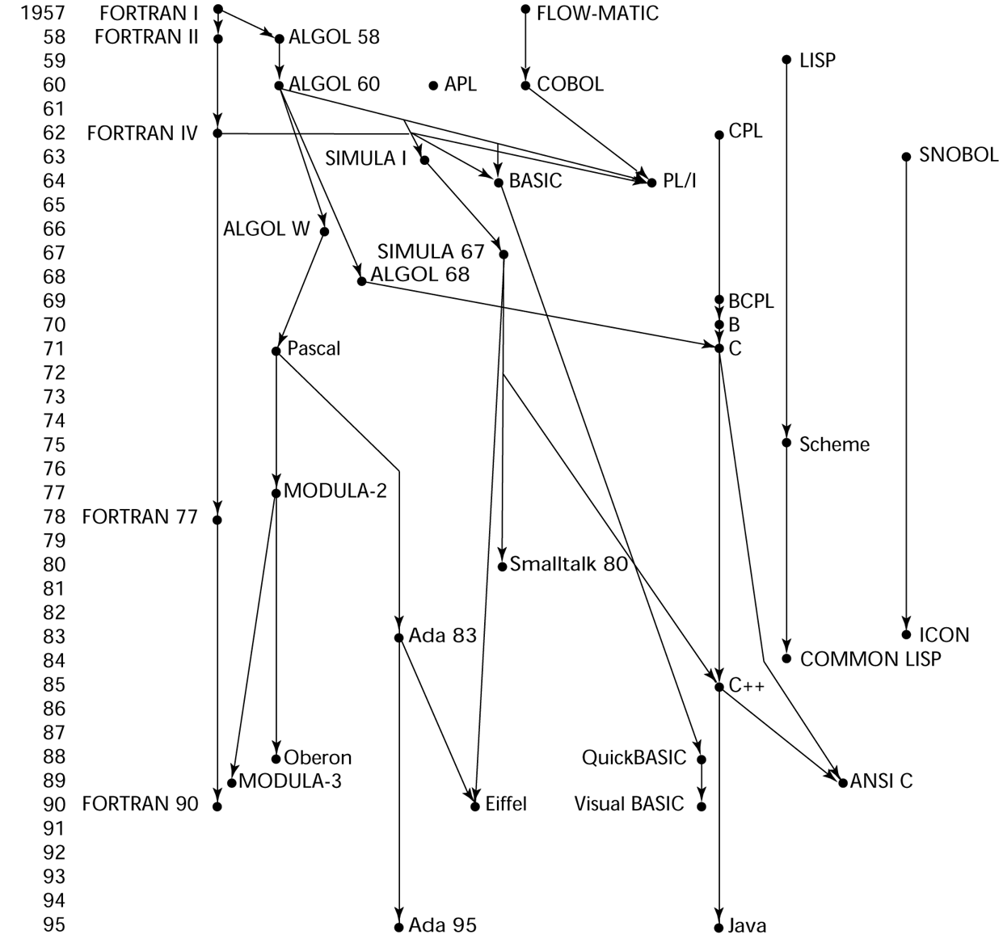
Genealogy of Languages

Slide 4
Programming Languages – A Brief History
Charles Babbage was the first true computer designer, and Ada Lovelace was history’s first programmer.
The First Programmer was a Lady.
Difference Engine (1822)
To calculate finite difference table for Numerical Analysis
Analytical Engine (1833) – key features
Memory (called store), jump, loop, subroutines

Slide 5
Zuse’s Plankalkül – 1945
Discovered and Published in 1972
Never implemented
Advanced data types and structures
floating point, arrays, records, nesting in records
No explicit goto
Iteration
Selection without else part
Solved problems
Sorting
Graph connectivity
Integer and floating point arithmetic
Expressions with operator precedence
Chess playing

Slide 6
Pseudo-codes
What was wrong with using machine code?
Poor readability
Poor modifiability
Expression coding was tedious
Machine deficiencies - no indexing or fl. pt.
Short code; 1949; BINAC computer; by Mauchly
Expressions were coded, left to right
Speedcoding; 1954; for IBM701, by Backus
Pseudo ops for arithmetic and math functions
Conditional and unconditional branching
Autoincrement registers for array access
Slow!
Only 700 words left for user program

Slide 7
Laning and Zierler System - 1953
Implemented on the MIT Whirlwind computer
First "algebraic" compiler system
Subscripted variables, function calls, expression translation
Never ported to any other machine

Slide 8
Fortran I - 1957
FORmula TRANslating system
First implemented version of FORTRAN
(FORTRAN 0 - 1954 - not implemented)
First compiled high-level language
Designed for the new IBM 704, which had index registers and floating point hardware
Environment of development:
Computers were small and unreliable
Applications were scientific
No programming methodology or tools
Machine efficiency was most important
No need for dynamic storage
Need good array handling and counting loops
No string handling, decimal arithmetic

Slide 9
Fortran I (continued)
Names could have up to six characters
Post-test counting loop (DO)
Formatted I/O
User-defined subprograms
3-way selection statement (arithmetic IF)
No data typing statements – i,j,k,l,m,n implicitly int
Compiler released in April 1957, after 18 worker/years of effort
Programs larger than 400 lines rarely compiled correctly, mainly due to poor reliability of 704
Code was very fast
Quickly became widely used

Slide 10
Fortran II (1958)
Independent compilation
Fix bugs
Fortran IV (1960)
Explicit type declarations
Logical selection statement
Subprogram names could be parameters
ANSI standard in 1966

Slide 11
FORTRAN 77 – 1977
Structured Programming
Character string handling
Logical loop control statement
IF-THEN-ELSE statement
FORTRAN 90 – 1990
Dynamic arrays
Pointers
Recursion
CASE statement
Parameter type checking
FORTRAN Evaluation
Dramatically changed forever the way computers are used

Slide 12
LISP - 1959
LISt Processing language (at MIT by McCarthy)
AI research at MIT (Linguistic, psychology, and mathematics) Needed a language that:
Process data in lists (rather than arrays)
Symbolic computation (rather than numeric)
Only two data types: atoms and lists
Pioneered functional programming
No need for variables or assignment
Control via recursion and conditional expressions
Still the dominant language for AI
COMMON LISP and Scheme are dialects of LISP
ML, Miranda, and Haskell are related languages

Slide 13
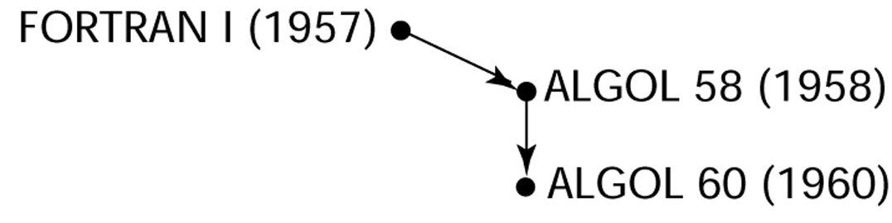
ALGOL

Slide 14
ALGOL 58 – 1958 Search for a “Universal Language”
Environment of development:
FORTRAN had (barely) arrived for IBM 70x and was owned by IBM
Many other languages were being developed, all for specific machines
No portable language; all were machine-dependent
No universal language for communicating algorithms
Goals of the language:
Close to mathematical notation
Good for describing algorithms
Machine independent, algorithmic language for use on all kinds of computers.

Slide 15
Algol 58 (Continued)
Language Features:
Concept of type was formalized
Names could have any length
Arrays could have any number of subscripts
Lower bound could be defined
Parameters were separated by mode (in & out)
Subscripts were placed in brackets
Compound statements (begin ... end)
Semicolon as a statement separator
Assignment operator was :=
if had an else-if clause
Not meant to be implemented, but variations of it were (MAD, JOVIAL)
Although IBM was initially enthusiastic but vested interest in FORTRAN resulted in taking back all support by mid-1959

Slide 16
Algol 60 - 1960
Modified ALGOL 58 at 6-day meeting in Paris
New Features:
Block structure (local scope)
Two parameter passing methods
Subprogram recursion
Stack-dynamic arrays
Still no i/o and no string handling

Slide 17
Algol 60 (Continued)
Success:
standard way to publish algorithms for over 20 years
All subsequent imperative languages are based on it
First machine-independent language
First language whose syntax was formally defined (BNF)
Had impact on hardware design
Failure:
Never widely used, especially in U.S.
Reasons:
No i/o and the character set made programs non-portable
Too flexible - hard to implement
IBM’s interest in FORTRAN
Formal syntax description – BNF was considered strange and complicated

Slide 18
Algol 68 - 1968
From the continued development of ALGOL 60, but it is not a superset of that language
Design is based on the concept of orthogonality
Contributions:
User-defined data structures
Dynamic arrays (called flex arrays)
Comments:
Had even less usage than ALGOL 60
Had strong influence on subsequent languages, especially Pascal, C, and Ada

Slide 19
Cobol - 1960
Design goals:
Business-oriented computation
Must look like simple English
Must be easy to use, even if that means it will be less powerful
Must broaden the base of computer users
Problems
Design committee were all from computer manufacturers and DoD branches
Design Problems:
arithmetic expressions?
subscripts?

Slide 20
Cobol (continued)
Contributions:
First macro facility in a high-level language
Hierarchical data structures (records)
Nested selection statements
Long names (up to 30 characters), with hyphens
Data Division
Fixed-point arithmetic
Comments:
First language required by DoD; would have failed without DoD
Still a very widely used business applications language
Very popular in business and government, much less at universities.
Warning: Study of Cobol Cripples the mind So its teaching should be regarded as a Criminal Offence.

Slide 21
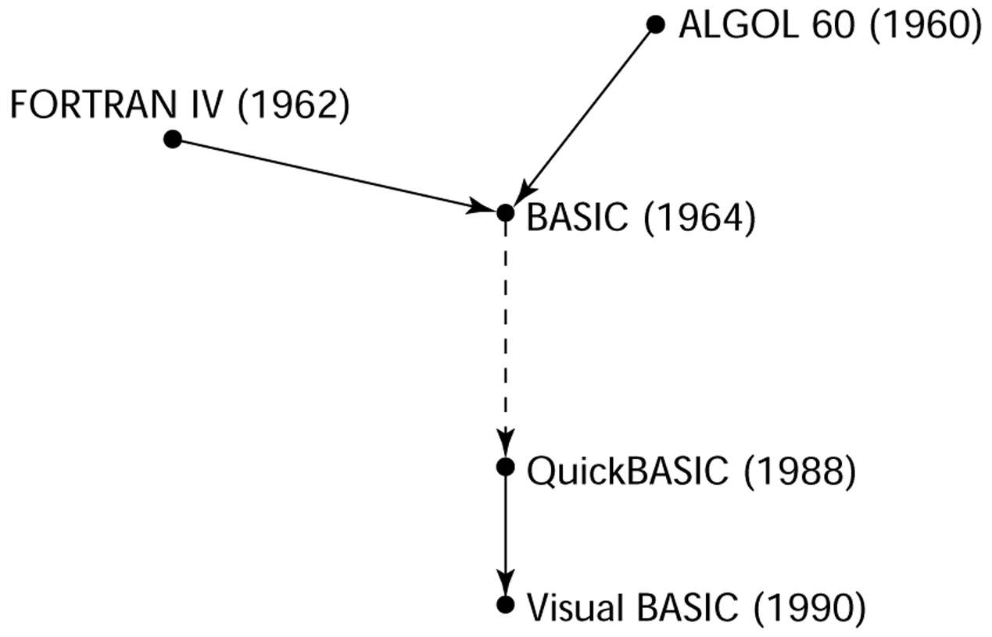
Basic - 1964
Designed by Kemeny & Kurtz at Dartmouth College
Design Goals:
Easy to learn and use for non-science students
Must be ”pleasant and friendly“
Fast turnaround for homework
Free and private access
User time is more important than computer time
Current popular dialects:
QuickBASIC and
Visual BASIC

Slide 22
PL/1 – 1965 - Everything for Everybody
Computing situation in 1964 (IBM's point of view)
Scientific computing
IBM 1620 and 7090 computers
FORTRAN
SHARE user group
Business computing
IBM 1401, 7080 computers
COBOL
GUIDE user group
User Community in 1963
Scientific users need more elaborate i/o, like COBOL had
Business users began to need fl. pt. and arrays (MIS)
It looked like many shops would begin to need two kinds of computers, languages, and support staff--too costly
The obvious solution:
Build a new computer to do both kinds of applications
Design a new language to do both kinds of applications

Slide 23
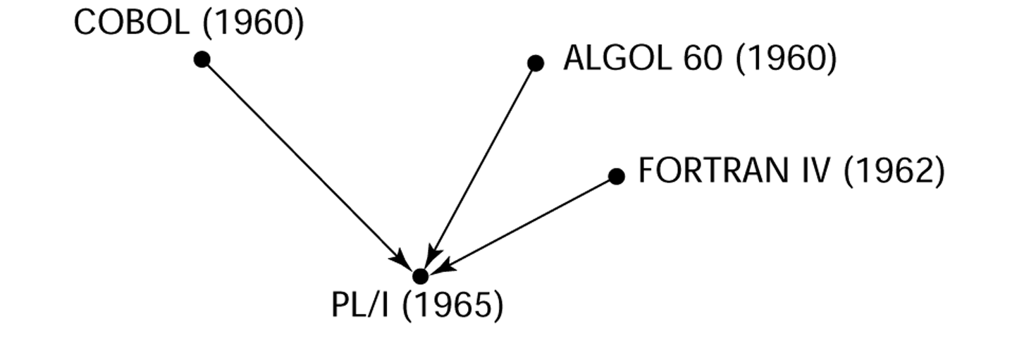
PL/1 - 1965

Slide 24
Pl/1 (Continued)
PL/I contributions:
First unit-level concurrency
First exception handling
First pointer data type
Comments:
Many new features were poorly designed
Too large and too complex
Was actually used for both scientific and business applications

Slide 25
Early Dynamic Languages
Characterized by dynamic typing and dynamic storage allocation
APL (A Programming Language) 1962
Designed as a hardware description language (at IBM by Ken Iverson)
Highly expressive (many operators, for both scalars and arrays of various dimensions)
Programs are very difficult to read commonly known as “write-only” language
SNOBOL (1964)
Designed as a string manipulation language (at Bell Labs by Farber, Griswold, and Polensky)
Powerful operators for string pattern matching

Slide 26
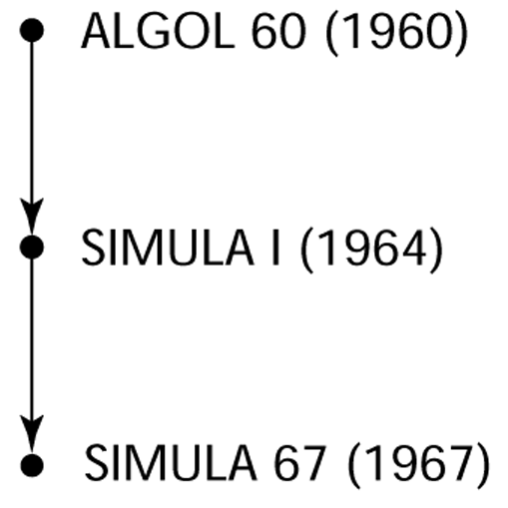
Simula 67 - 1967
Designed primarily for system simulation (in Norway by Nygaard and Dahl)
Based on ALGOL 60 and SIMULA I
Primary Contribution:
Coroutines - a kind of subprogram - Implemented in a structure called a class
Classes are the basis for data abstraction
Classes are structures that include both local data and functionality

Slide 27
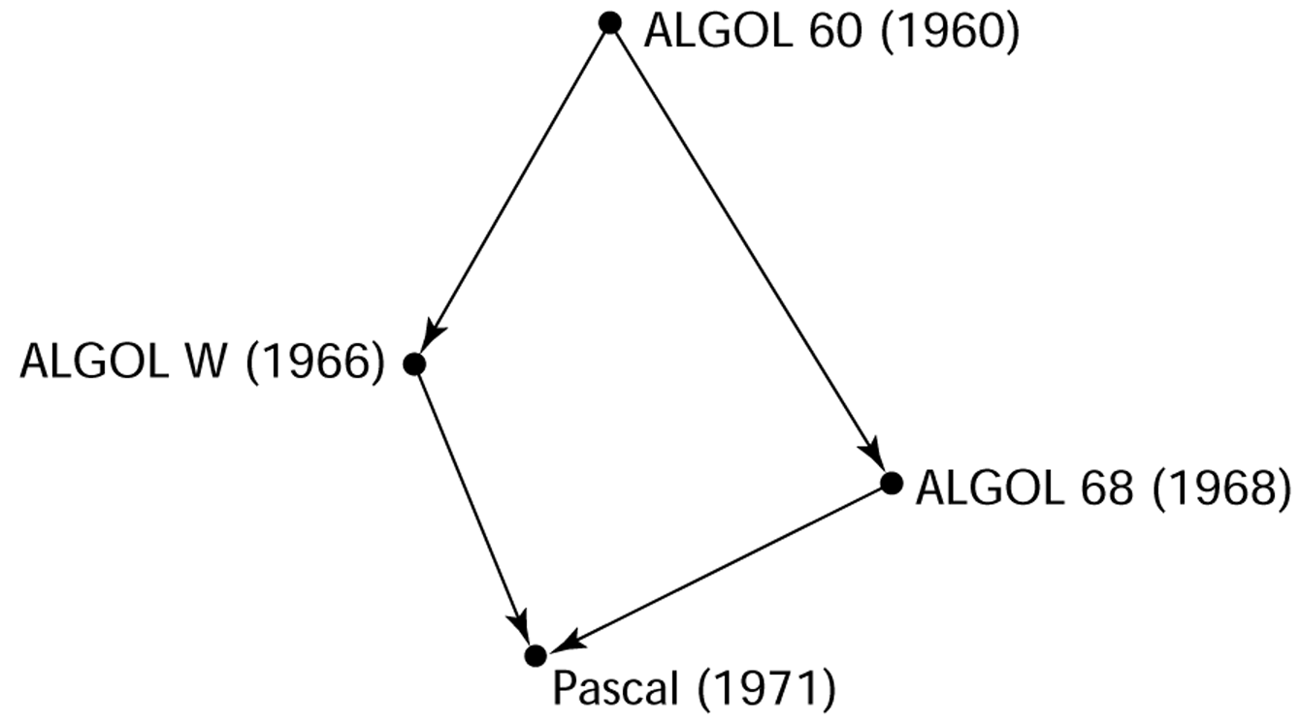
Pascal – 1971 - Simplicity by Design
Designed by Niklaus Wirth, who quit the ALGOL 68 committee (didn't like the direction of that work)
Designed for teaching structured programming
Small, simple, nothing really new
Very widely used language for teaching programming in colleges (but its use is shrinking)

Slide 28
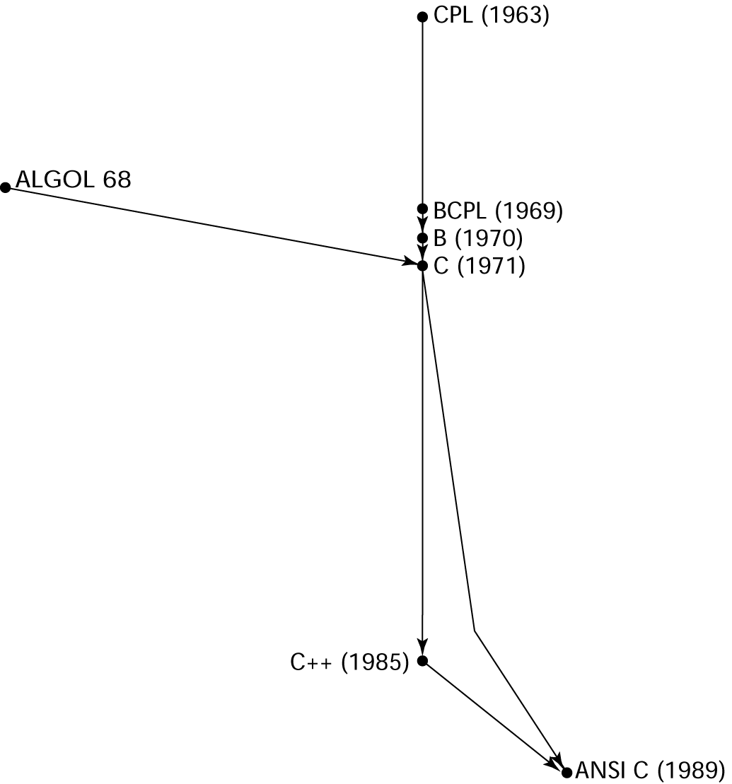
C - 1972
Designed for systems programming (at Bell Labs by Dennis Richie)
Evolved primarily from B, but also ALGOL 68
Powerful set of operators, but poor type checking
Initially spread through UNIX

Slide 29
Prolog - 1972
Developed at the University of Aix-Marseille (france), by Comerauer and Roussel, with some help from Kowalski at the University of Edinburgh (UK)
Based on formal logic
Non-procedural - Declarative, non­deterministic (built­in backtracking).
Associative memory, pattern­directed procedure invocation.

Slide 30
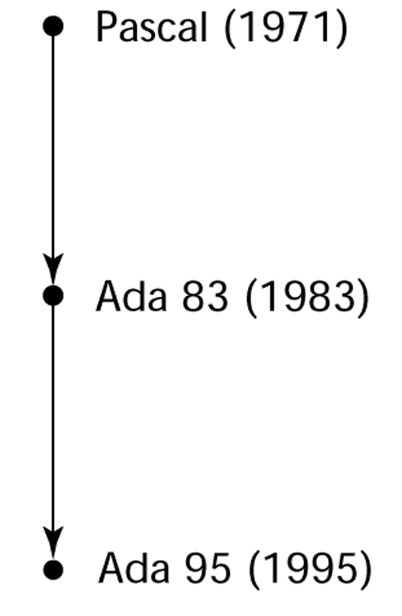
Ada – 1983 - History’s largest design effort
Huge design effort, involving hundreds of people, much money, and about eight years
Contributions:
Packages - support for data abstraction
Exception handling - elaborate
Generic program units
Concurrency - through the tasking model
Comments:
Competitive design
Included all that was then known about software engineering and language design
First compilers were very difficult;
the first really usable compiler came nearly five years after the language design was completed

Slide 31
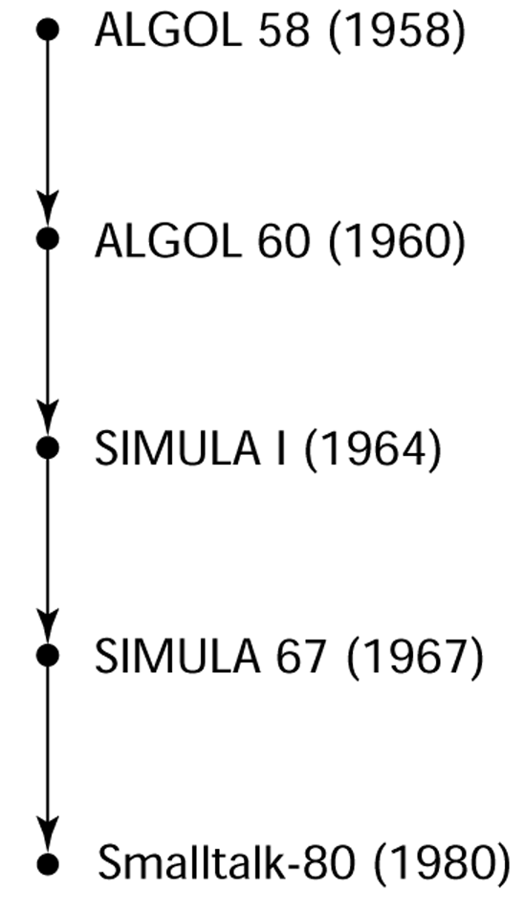
Smalltalk - 1972-1980
Developed at Xerox PARC, initially by Alan Kay, later by Adele Goldberg
First full implementation of an object-oriented language (data abstraction, inheritance, and dynamic type binding)
Purest object-oriented language yet!
Pioneered the graphical user interface (of windows) everyone now uses

Slide 32
C++ - 1985
Developed at Bell Labs by Bjarne Stroustrup
Evolved from C and SIMULA 67
Facilities for object-oriented programming, taken partially from SIMULA 67, were added to C
Also has exception handling
A large and complex language, in part because it supports both procedural and OO programming
Rapidly grew in popularity, along with OOP
ANSI standard approved in November, 1997

Slide 33
Java - 1995
Developed at Sun in the early 1990s
Based on C++
Significantly simplified
Supports only OOP
Has references, but not pointers
Includes support for applets and a form of concurrency

Slide 34
Programming Languages - Evolution
Discovery and description (→) of PL concepts – 50’s
empirical approach
PL regarded as tools for facilitating specification of programs rather than as interesting objects of study in their own right.
Analysis and elaboration (→) – 60’s
Mathematical approach
Theoretical research as an end in itself
Software Engineering Support – 70’s - structured design
Software Engineering Support – 80’s - OO design
Software Engineering Support – 90’s - Internet

Slide 35
Discovery and Description – 50’s
Development of symbolic assembly langauge, macro-assembly, FORTRAN, Algol 60, COBOL, Lisp.
Discovery of many of the basic implementation techniques
Symbol table construction and look-up
Stack algorithms for evaluating arithmetic expressions
Activation record stack
Marking algorithms for garbage collection

Slide 36
Elaboration and Analysis – 60’s
Analysis for the purpose of constructing models and theories of programming languages
PL/1, Simula, Algol 68, Snobol.
Elaboration of early languages
Attempt to achieve greater richness by synthesis of existing features and generalization
Resulted in greater complexity
Formal languages and automata theory with application to parsing and compiler theory
Language definition techniques

Slide 37
Software Engineering Support – 70’s
From pure research to practical management of the environment
Decreasing hardware cost and increasing software cost – complexity barrier
Development of tools and methodologies for controlling the complexities, cost and reliability of large programs
Structured programming, modular design, verification.

Slide 38
The programming environment may be larger than the language 80’s – 90’s
The predefined libraries are indispensable to the proper use of the language.
the C++ standard template library
The Java Swing classes
The Ada I/O and numeric packages

Slide 39
1980’s, 1990’s and onward Support for SE continued Object Oriented, Internet, Mobile Computing Machine Learning and Beyond …

